Slide 1
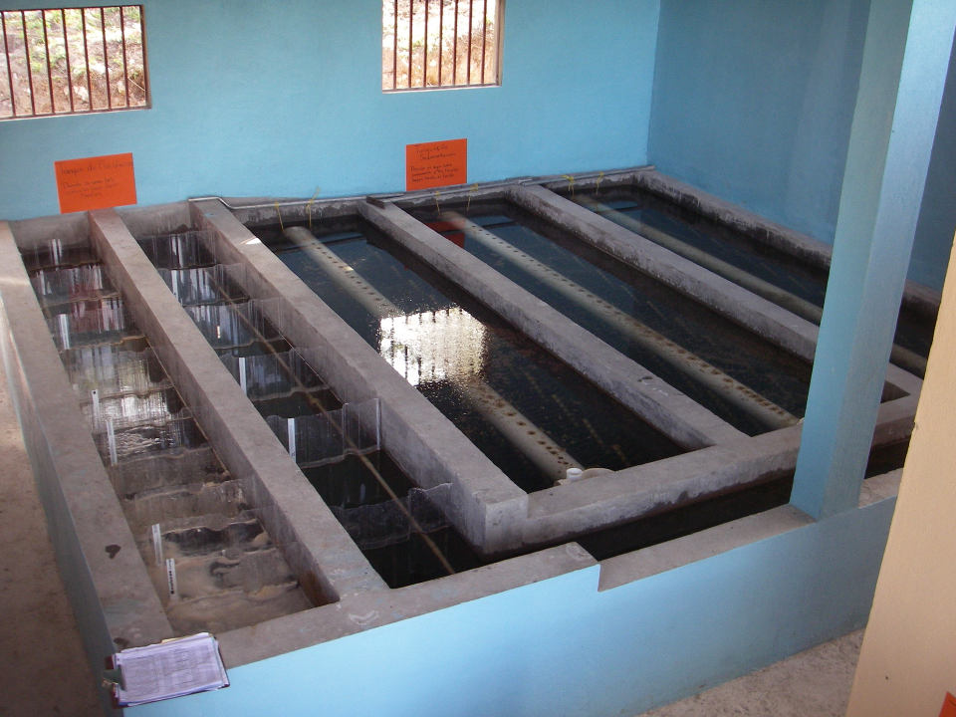
Flocculation Introduction

Slide 2
Overview
Options for separating contaminants from water
Sedimentation doesn’t remove pathogens fast enough!
Ganging up on gravity (flocculation)
Sticky nanoparticles

Slide 3
Exploit differences between water and the contaminant to separate them
Difference
Size
Density
Molecular Polarity
Magnetism
Electrical charge
Optical properties

Slide 4
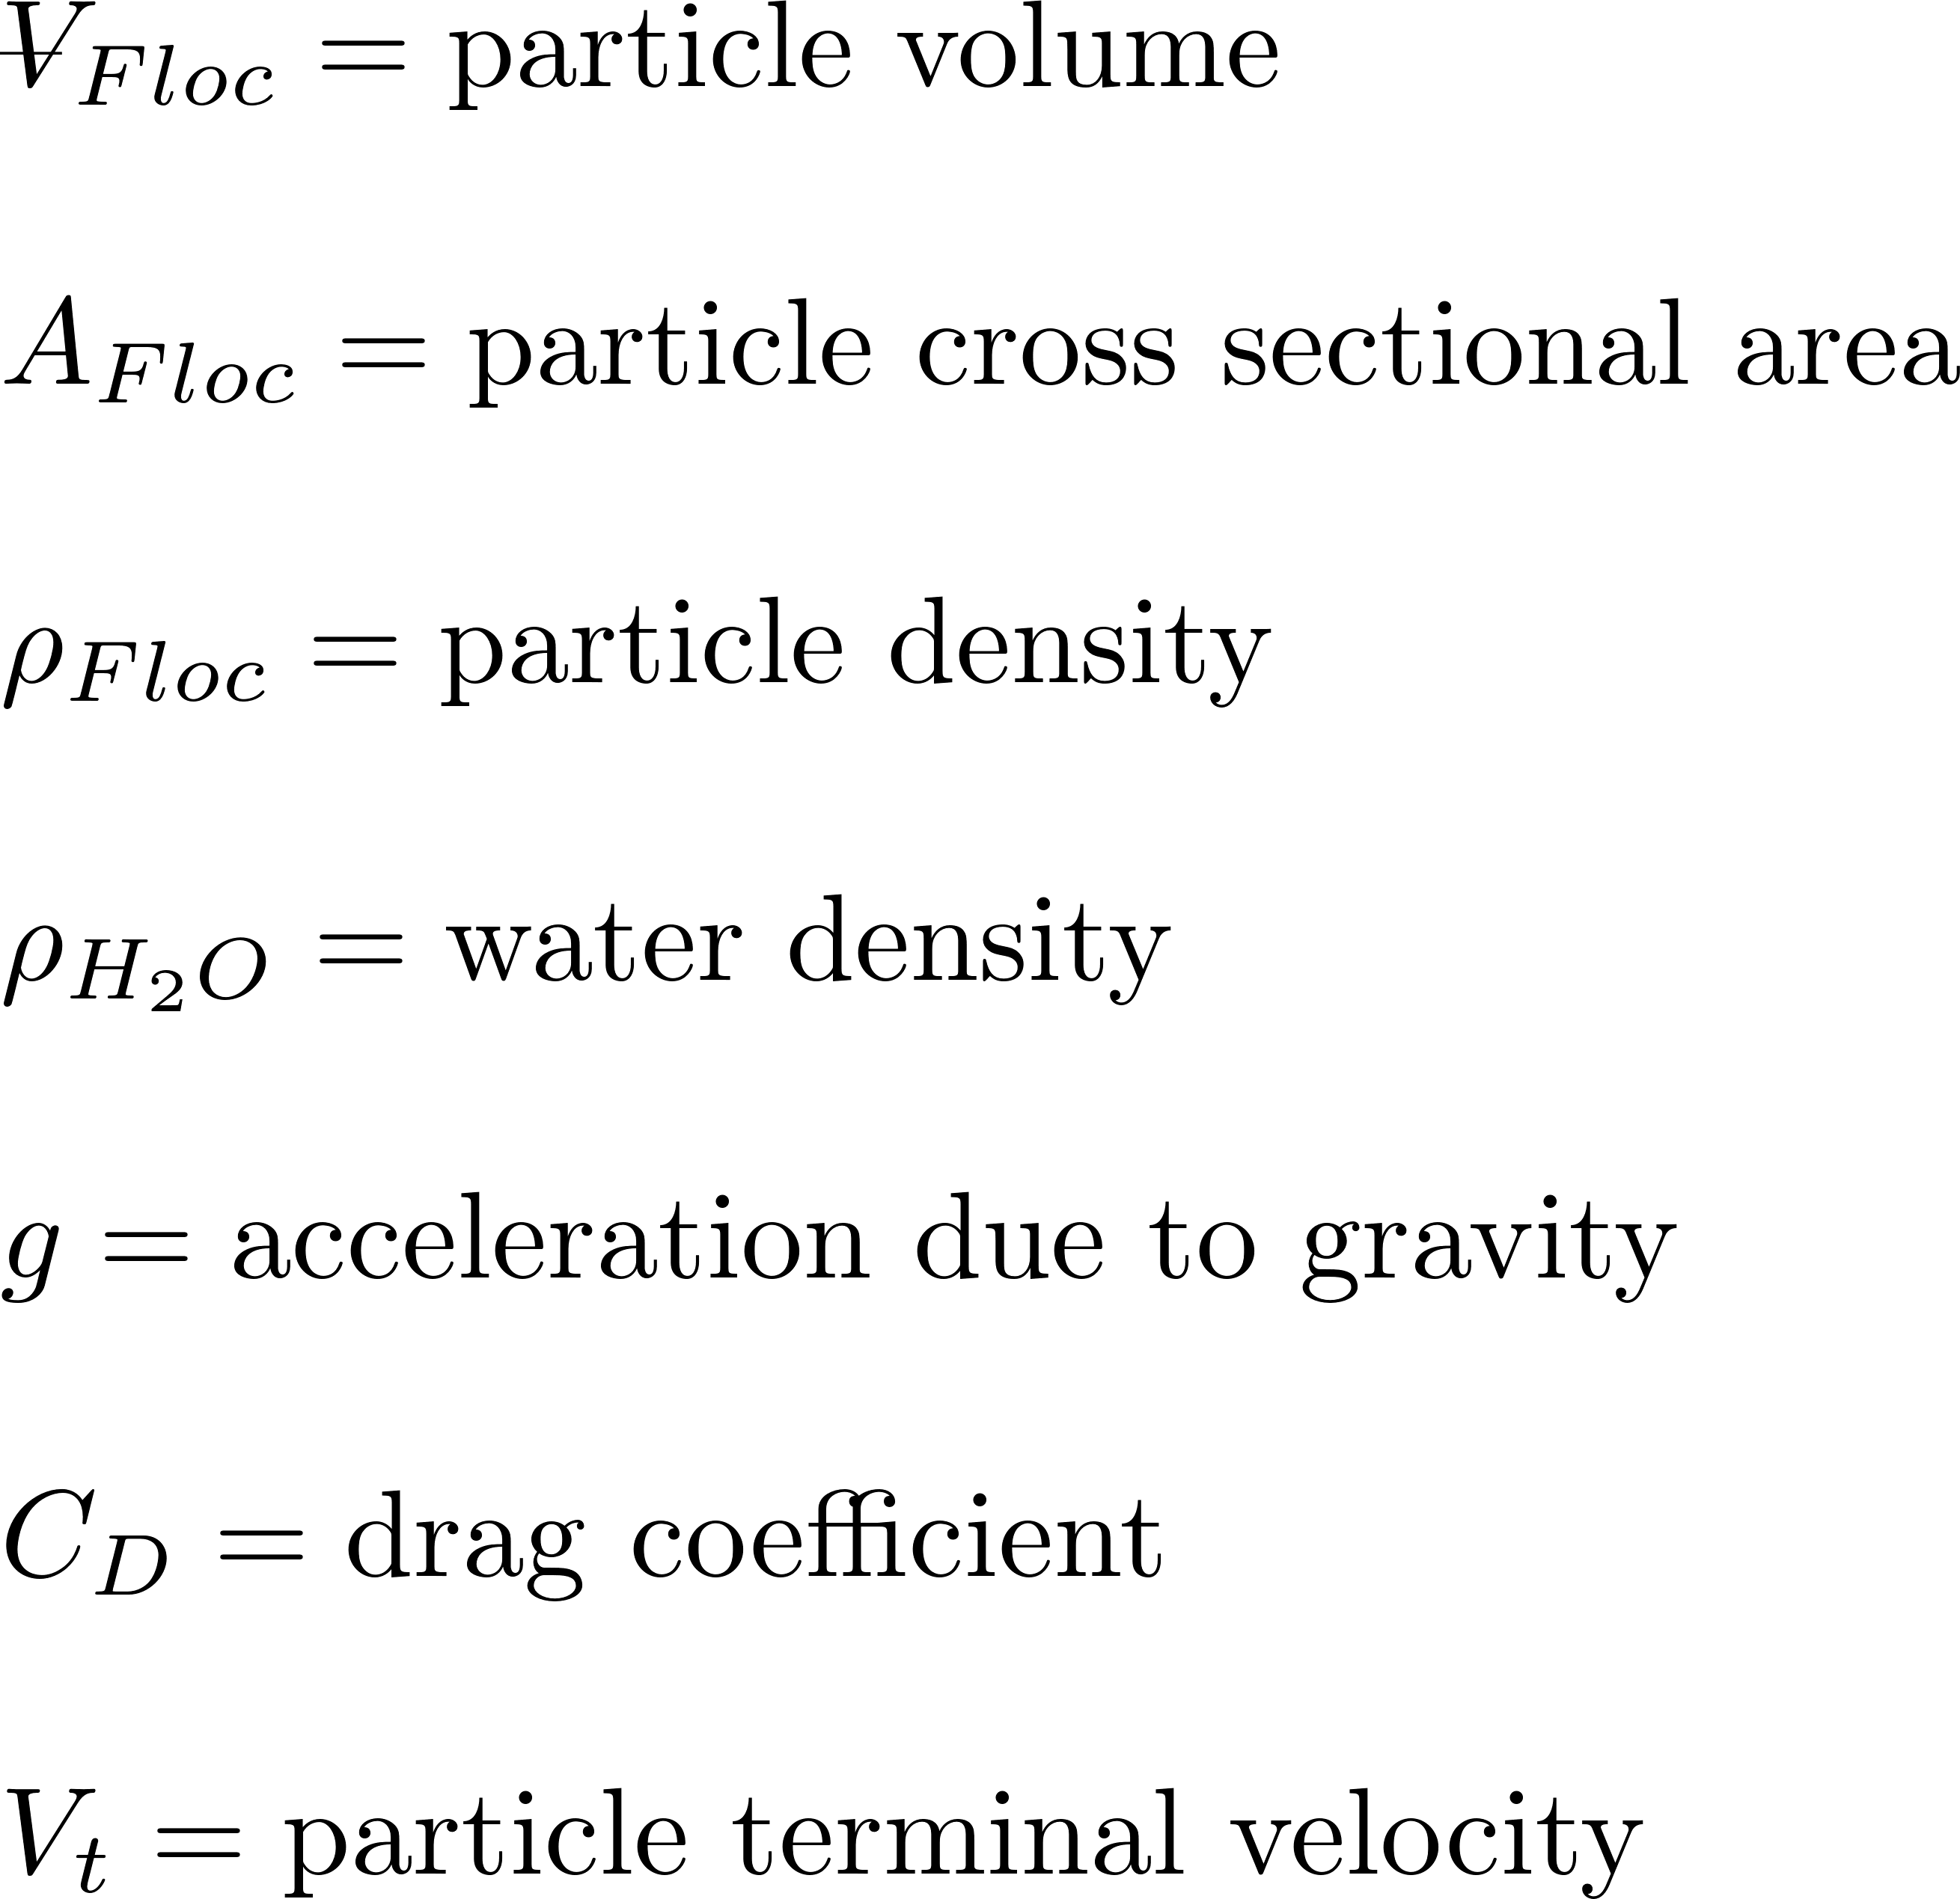

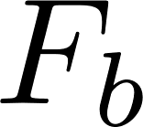
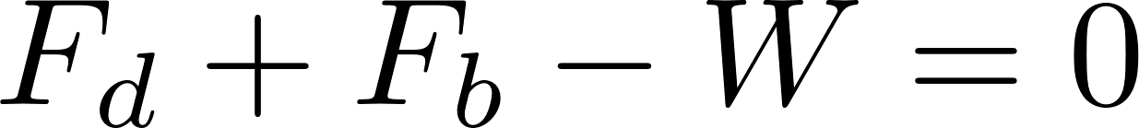
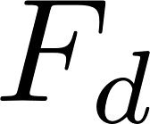
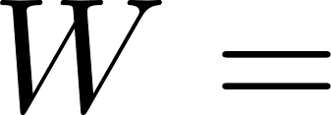
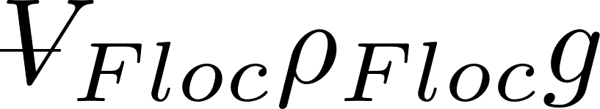
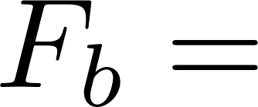
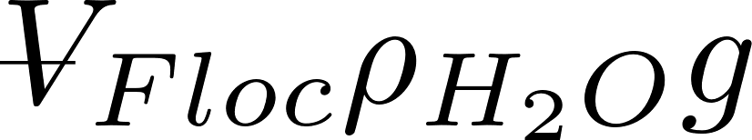
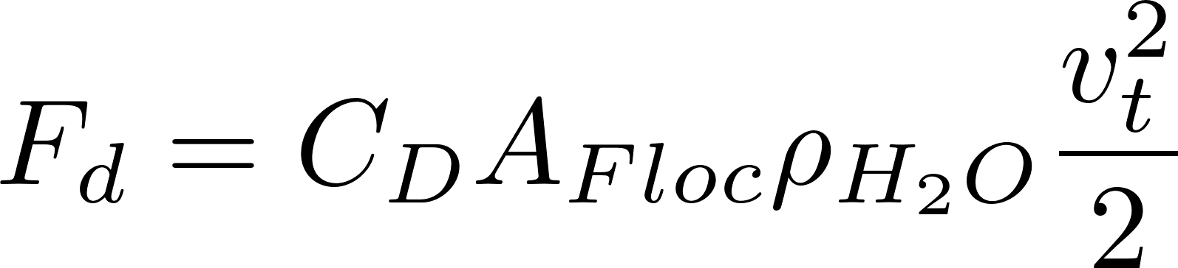

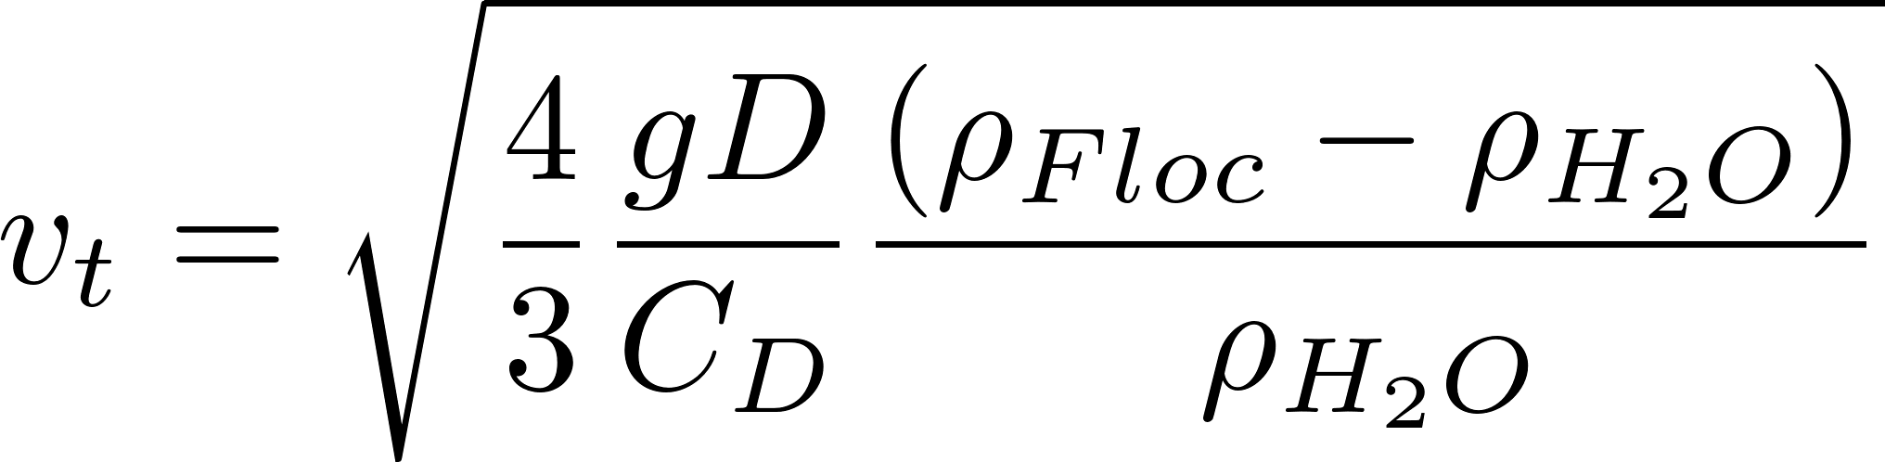
Sedimentation: Particle Terminal Fall Velocity
projected
Identify forces

Slide 5
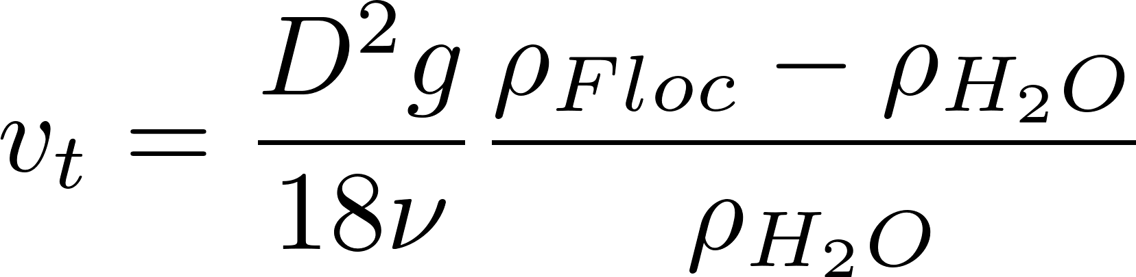
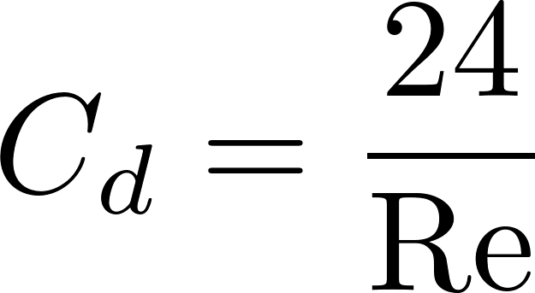
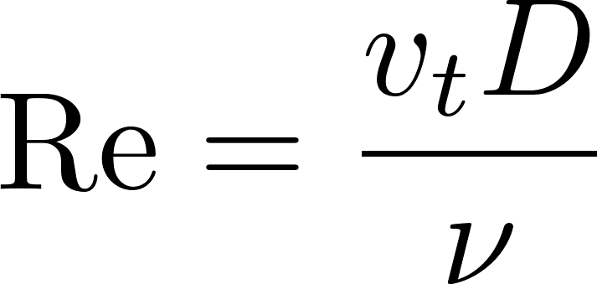
Drag Coefficient on a Sphere
Stokes Law
laminar
turbulent
turbulent boundary

Slide 6
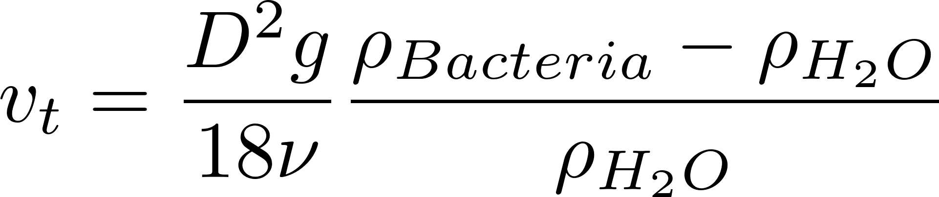
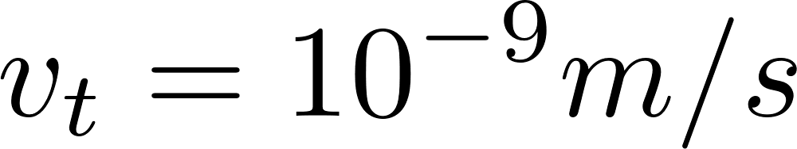
Sedimentation is too slow for pathogens and clay
10⁻¹²
10
10⁻³
10⁻⁶

Slide 7
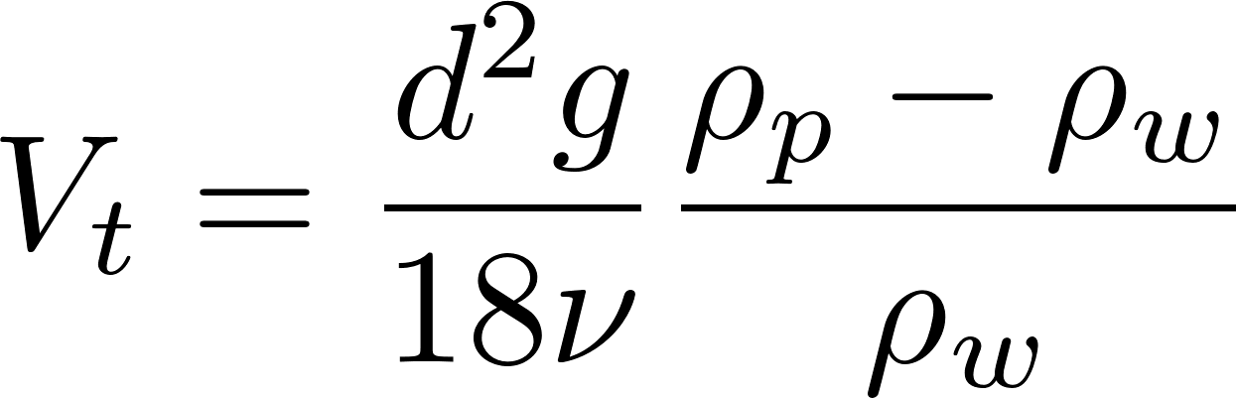
Gravity separation is awesome, but we need help
How could we increase the sedimentation rate of small particles?
Increase d (stick particles together)
Increase g (centrifuge)
Increase density difference
(dissolved air flotation)
Decrease viscosity (increase temperature)
Notes:
Deriving the equations that show what matters is a useful skill in design. I’m currently working on designing our stacked rapid sand filters and I went through a long derivation to determine the size of the pipes needed for the filter. And then I looked at the equation and realized that I could get better results if I changed my assumptions about how the filter would be built! If I had done an iterative or numerical analysis I would have missed that insight!

Slide 8
Flocculation
A process where we create the conditions so that particles can attach to each other
Requires two things
Transport
Attachment
The point of contact must be sticky
The goal of flocculation is to have all particles attach to each other and form flocs that settle faster
Notes:
A process that transforms a turbid suspension of tiny particles into a turbid suspension of big particles!
Requires
Sticky particles (splattered with adhesive nanoparticles)
Successful collisions between particles
Flocs are fractals (“the same from near as from far”)
The goal of flocculation is to reduce the number of small particles (that haven’t been flocculated)
One goal is to understand why some particles are always left behind (turbidity after sedimentation)
Another goal is to learn how to design a flocculator

Slide 9
Transport processes to create collisions between particles (clay and pathogens)
Transport mechanism | Does it help flocculation?
Differential sedimentation (larger particles settle faster) | No! Not significant because particles of different sizes can’t get close enough to each other to attach because of the boundary layer thickness on the larger particle
Turbulent mixing | No! The smallest turbulent eddies are so large that both particles are in the same eddy
Viscous shear (fluid deformation) | YES!!!!!
Molecular diffusion | No! Too slow for particles that are smaller than about 1 μm (very important for transporting coagulant nanoparticles and dissolved organic molecules)
Molecular forces (Van der Waals force etc.) | No! Only act over lengths of a few nm and thus are not significant

Slide 10


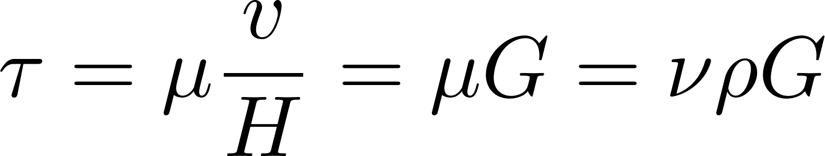
Fluids deform continuously (velocity gradient - G) given a stress (τ)
Dynamic viscosity
Kinematic viscosity
Velocity gradient

Slide 11
Definitions
Coagulation: The process of adding a sticky solid phase material (adhesive nanoparticles) that attaches to the particles so they can attach to each other (the topic of these notes)
Flocculation: The process of producing collisions between particles to create flocs (aggregates) (next set of notes)

Slide 12
Sticky nanoparticles?
Effective flocculation only occurs when the coagulant is in the solid phase
Thus NaOH and Ca(OH) ₂ are not effective coagulants because they are soluble at neutral pH
Al(OH)₃ likes to stick to itself and to other surfaces
Why is the solid phase Al(OH)₃ and Al₁₃O₄(OH)₂₄ ⁷⁺ sticky? (Perhaps because it is more polar than water)

Slide 13
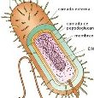
Seeking favorable interactions between particles
We add a sticky insoluble coagulant that forms nanoparticles
We design reactor geometry and flow regimes to create interactions between
Nanoparticles of coagulant precipitate
Dissolved organic molecules
Inorganic particles (like clay)
Organic particles (including pathogens)

Slide 14
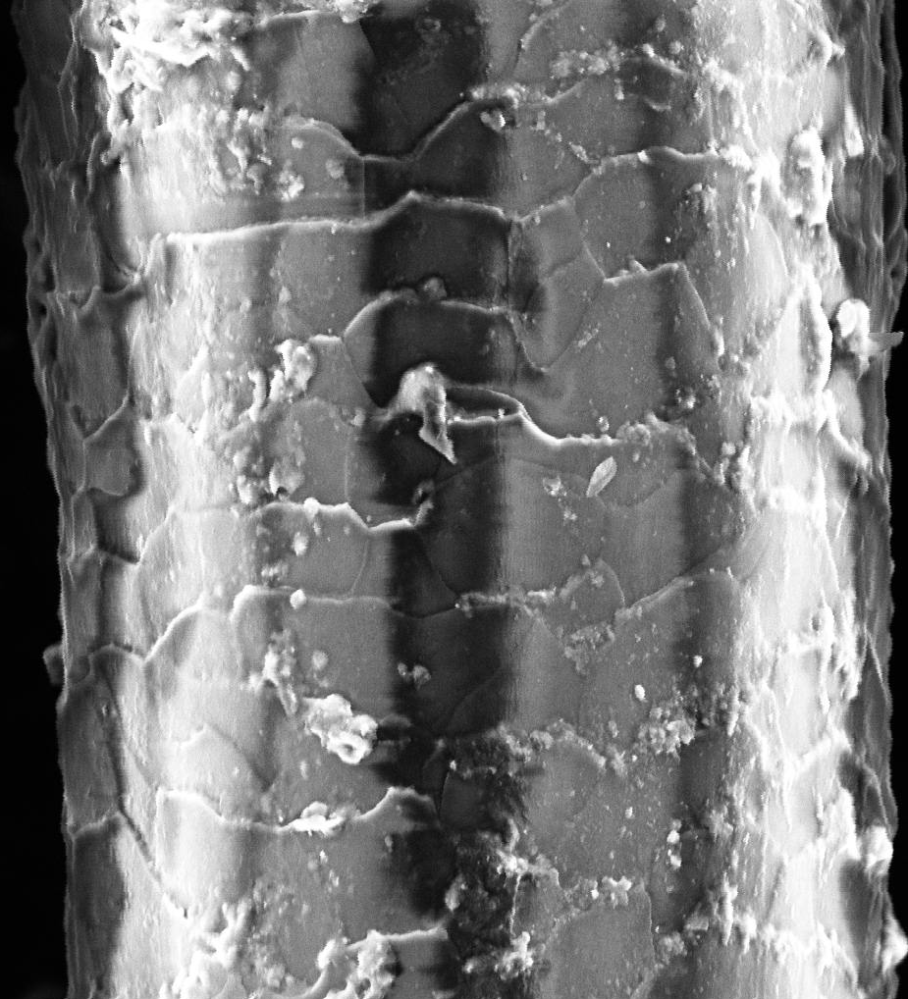
Human hair is 50 mm in diameter
clay
bacterial cell
Coagulant nanoparticle

Slide 15
Sizes of a few particles
clay
7000 nm, 7 μm, 0.007 mm
bacteria
1000 nm, 1 μm, 0.001 mm
Nanoparticle of coagulant
90 nm, 0.09 μm
Natural organic matter
50 nm, 0.05 μm

Slide 16
How much coagulant should we add?
Our hypothesis:
When one clay platelet contacts another clay platelet, they will stick together if and only if there is a clean coagulant nanoparticle surface at the point of contact
We expect some aggregation to occur even with very low coagulant dosages
clay

Slide 17
Aluminum Sulfate Chemistry Alum [Al₂(SO₄)₃*14.3H₂O]
A widely used coagulant
Typically 10 mg/L to 100 mg/L alum is used (0.9 to 9 mg/L as Al)
High concentrations (stock solutions) don’t precipitate because the pH is low
The alum precipitates when it blends with the water in the water treatment plant
The primary reaction produces Al(OH)₃
Al₂(SO₄)₃ + 6H₂O→2Al(OH)₃ + 6H⁺ + 3SO₄⁻²
pH = -log[H⁺]

Slide 18
Acid Neutralizing Capacity (ANC or Alkalinity) Requirement
Al₂(SO₄)₃ + 6H₂O→2Al(OH)₃ + 6H⁺ + 3SO₄⁻²
ANC is measured as mg/L of CaCO₃
How much ANC is consumed by alum?
 | Alum | Calcium Carbonate
Molecular Formula | Al₂(SO₄)₃*14H₂0 | CaCO₃
Molecular mass | 600 g/mol | 100 g/mol
eq/mol | 6 | 2
Molecular mass/eq | 100 g/eq | 50 g/eq
Simple guide | 1 mg/L Alum consumes | 0.5 mg/L Calcium Carbonate ANC
This sets the maximum alum dose that can be used for low alkalinity waters
Notes:
CUWFP has 140 mg/L calcium carbonate alkalinity. Therefore never have a problem with pH dropping too far with the addition of alum.
What do you do if the water ANC is too low? Add base OR switch to a less acidic coagulant.

Slide 19
Polyaluminum Chloride (PACl)
Slowly titrated with a base (in the chemical plant) to produce a meta-stable and soluble polymeric aluminum (partially neutralized)
Consumes less alkalinity (ANC), it is less acidic.
Aluminum mass fraction is higher than in alum (no 14.3 H₂O) so the mass of PACl required is less than for alum (0.4-10 mg/L as Al)
Notes:
What is the chemical formula of PACl?

Slide 20
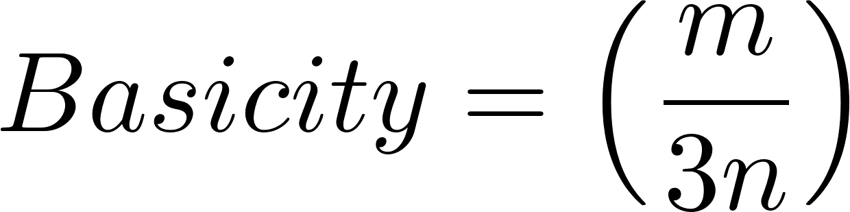
PACl Formula and Basicity [Al_{n}(OH)_{m}Cl_{3n−m}] _{x}
Basicity: Ratio of hydroxyl equivalents to aluminum equivalents
Basicity of 1 would mean that it does not produce any protons when it dissolves in water
0 means it produces 3 protons per Al (like alum)
The lowest basicity commercial PACls are about 10%
Most PACls are in the medium to high basicity range (50-70%)
Highest stable basicity (83%) is aluminum chlorohydrate (ACH) – would be useful for treating water with very low ANC
http://www.geosc.com/products/polyaluminum-chloride-(pac)
Notes:
http://wioa.org.au/conference_papers/2001/pdf/paper6.pdf

Slide 21
Evolving hypotheses
 | Previous Hypotheses | Previous predictions (proven incorrect) | Recent Hypotheses | Recent observed predictions
Particle attachment | Van der Waal forces (too weak to hold flocs together) | Coagulant won’t self aggregate because it is positively charged | noncovalent bonds or perhaps even covalent bonds
Role of coagulant | Neutralize the negative surface charge of particles | Flocculation will completely fail if surfaces become positively charged | Provide a sparse coating of coagulant nanoparticles on all particle surfaces | Particles attach over a wide range of coagulant dose
Particle collisions | Collisions between both similar and different sizes of particles occur | Primary particle concentration after flocculation should decrease when incoming primary particle concentration increases | Only similarly sized particles can collide | Primary particle concentration after flocculation is not significantly influenced by the incoming particle concentration
Notes:
This is a field where progress has been very slow over the past century. A key factor is that new insights required a combination of fluid dynamics and chemistry

Slide 22

Primary particle can not collide with a large floc in uniform shear* (edge of knowledge alert)
Thickness of viscous boundary layer, δ, scales with floc diameter
Only similar sized particles can extend through each other’s viscous boundary layer.
Notes:
I haven’t been able to find literature that demonstrates this effect.
Likely that the water contained within a floc simply rotates with the floc and that no new water enters the floc in a shear flow.

Slide 23
Similar sized particles can collide in a shear flow

Slide 24
Primary Particle collisions slow to a crawl when the primary particles are far apart
We need another strategy to capture particles including pathogens like Cryptosporidium
Notes:
This insight is key. Otherwise highly turbid water would be predicted to produce super clean settled water!

Slide 25
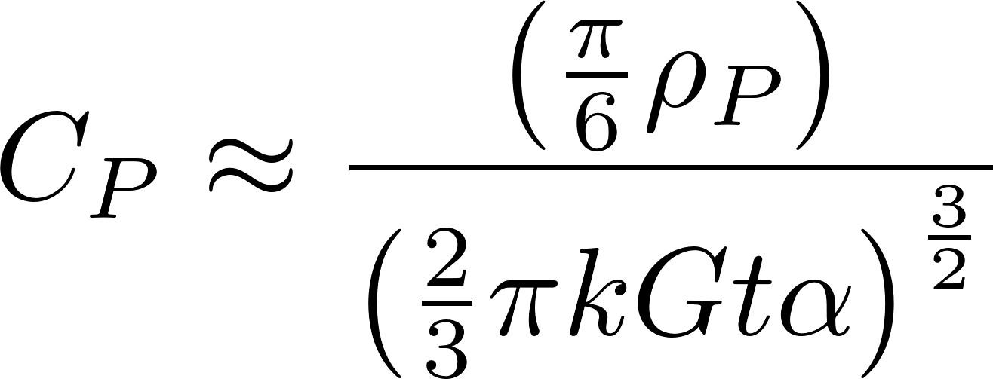
In shear flow only particles of similar size are able to collide
Higher turbidity raw water doesn’t produce cleaner water!
At the end of the flocculator the concentration of primary particles that haven’t flocculated is small and each collision takes a long time (rate limiting step)
The slow final stage of flocculation determines the final concentration of primary particles
A Hydrodynamic and surface coverage model capable of predicting settled effluent turbidity subsequent to hydraulic flocculation WH Pennock, ML Weber-Shirk, LW Lion
Environmental Engineering Science 35 (12), 1273-1285 (2018)
Notes:
The final concentration of primary particles is independent of the raw water turbidity

Slide 26
Wait! How do the coagulant nanoparticles get to the clay?
Molecular diffusion transports particles that are smaller than about 1 μm
Shear transports new fluid past the clay particles and molecular diffusion transports the nanoparticles through the viscous boundary layer!
Nanoparticles can diffuse through the boundary layer to the clay!

Slide 27
Preview: Flocculation, Floc Blanket, Sand Filtration
We are developing a unified theory of these three processes
In each process we are attempting to capture particles that are dominated by viscous forces
Prior to the AguaClara flocculation model none of these processes had physics-based equations describing particle removal efficiency during normal operation
There is still a LOT of work to be done here to understand how these processes work and hence how to optimize the design of drinking water treatment plants

Slide 28
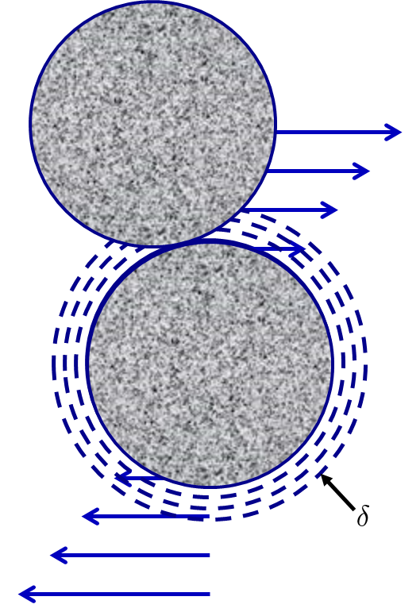
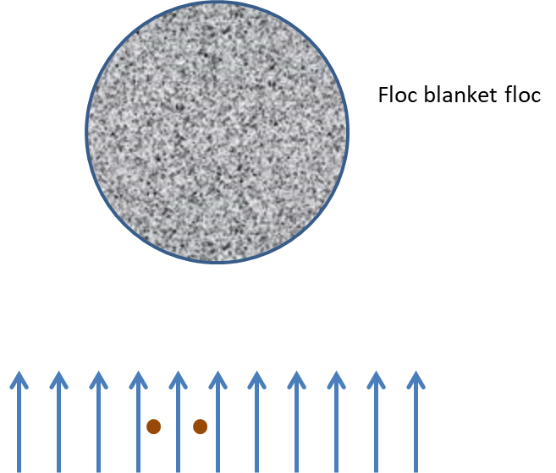
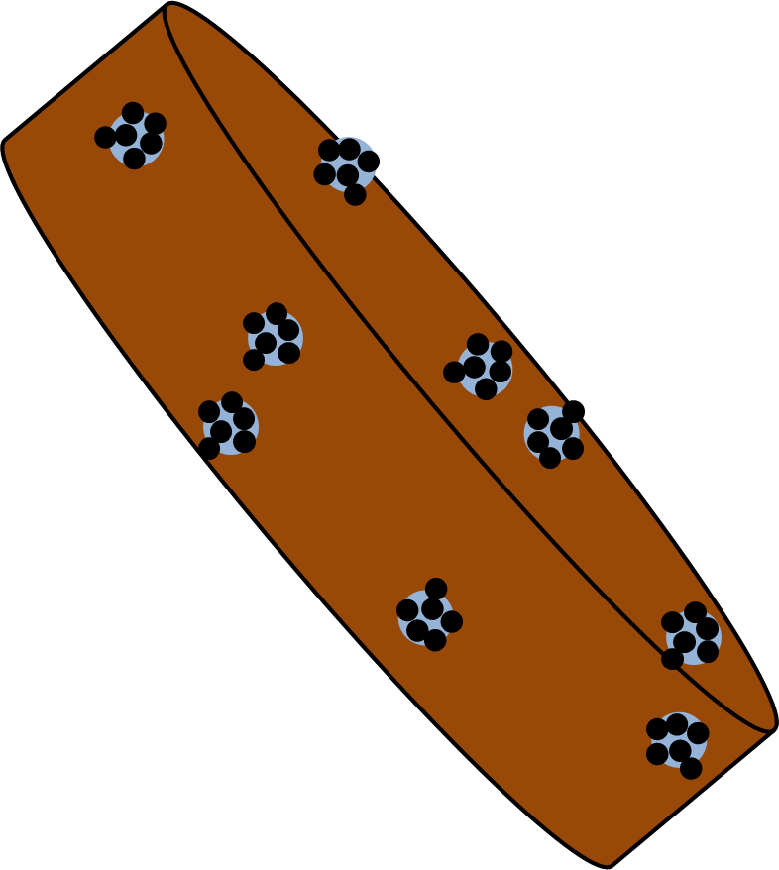
Preview: Core idea for 3 water treatment processes
In laminar flow only similarly sized particles can collide
In floc blankets small particles flow through large flocs where they can collide with small particles
Perhaps sand filters work by capturing flocs that then capture small particles!
Notes:
How do we know charge neutralization doesn’t explain flocculation
Floc aggregation begins even with very small dosages of coagulant long before the surface charge is neutralized
No transition in flocculation performance as the coagulant dose is gradually varied over a very wide range
No evidence of charge reversal causing deterioration in performance
A single physics-based model describes the full range of flocculation from low to high coagulant dosages
Coagulant nanoparticles are so large that they easily extend through the double layer and hence can directly bridge between two negatively charged particles
No one has been able to develop equations describing the role of charge neutralization
Confusion in the literature about whether WTPs use charge neutralization or sweep floc. No quantification of how you would know which hypothesized mechanism is operative

Slide 29
Coming up
How fast do flocs form?
What controls the rate of collisions between particles?
What do the resulting flocs look like?
How does this influence how we design the reactors to build the flocs (flocculators)?

